Slide 1
Rice Leaf Disease
Group Member:
Jiaxu Shi z5343710
Zhiyue Zheng z5389616
Daijiao Liu z5409640
Yanqi Zhu z5357925
Tong Xia z5360060

Slide 2
Part 01
INTRODUCTION
Part 02
METHODS & RESULTS
Part 03
DISCUSSION
Part 04
CONCLUSION

Slide 3
INTRODUCTION
Current issue:
High demand for rice
Aim:
detect leaf disease
Limit crop damage

Slide 4
Image Preprocessing
Name: Jiaxu Shi

Slide 5
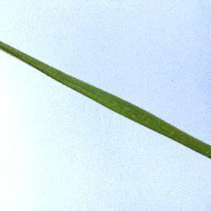
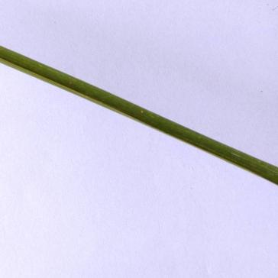
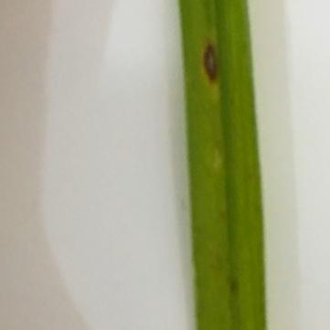
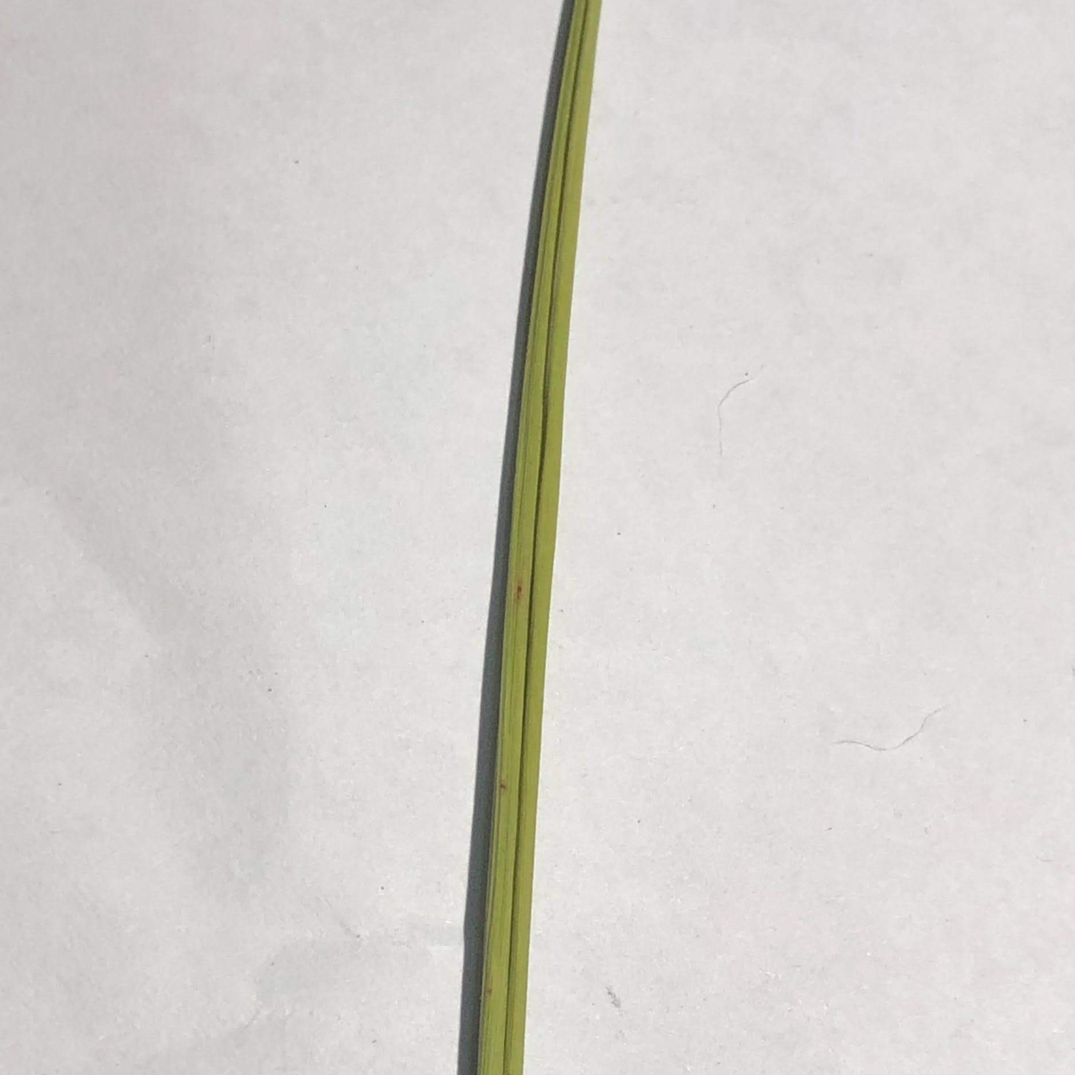
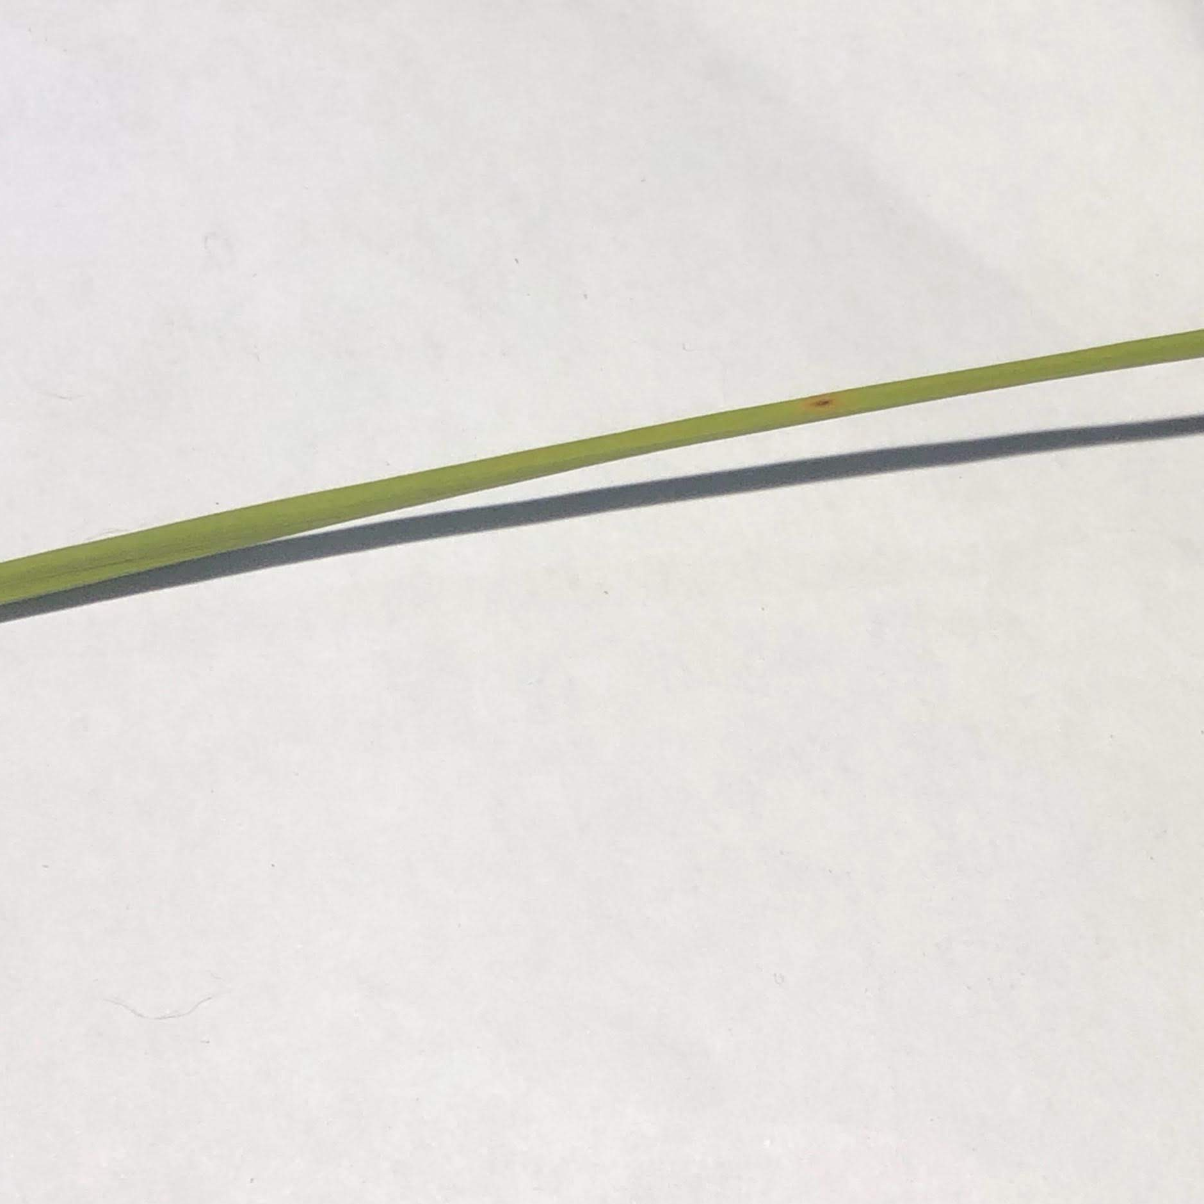
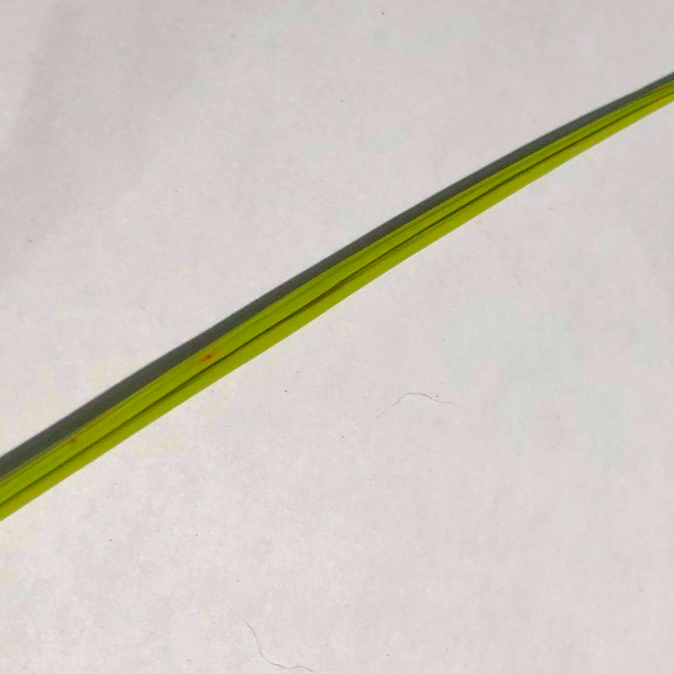
Problem：
Image Preprocessing
1. Background color
2. Proportion of leaves

Slide 6
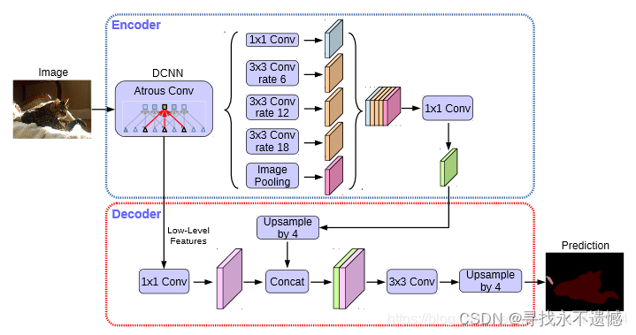
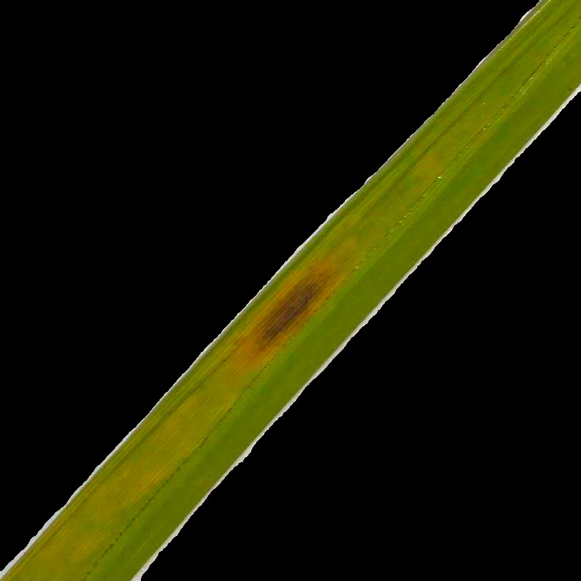
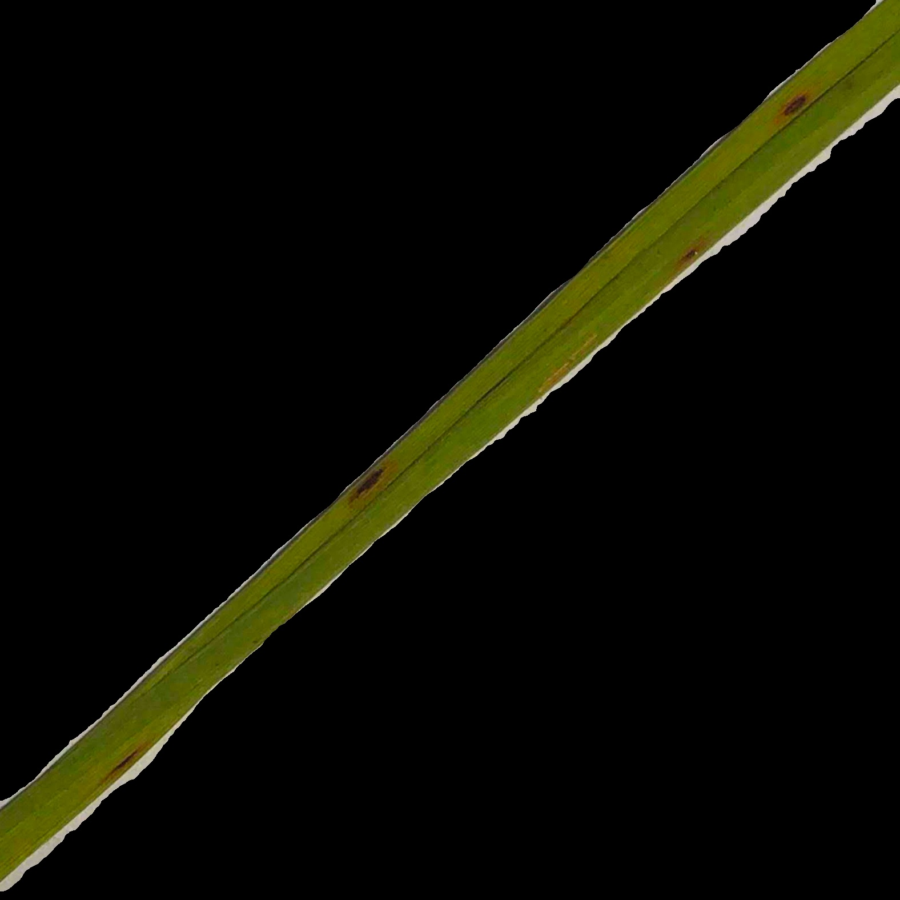
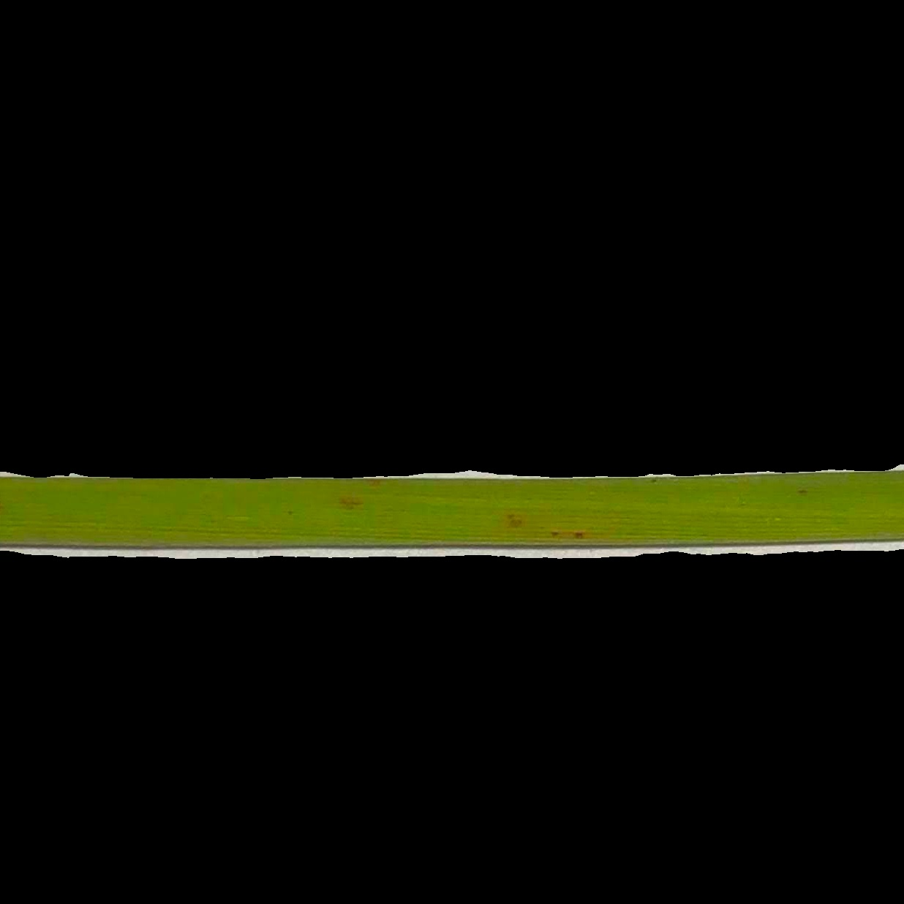
Methods：
1.Deeplabv3 Image Segmentation
result：
Notes:
the object structure and shape can be extracted as a feature vector by the distribution of intensity gradients
HOG is adopted as the baseline method because a). HOG emphasizes the shape and structure of the object in the image and b). it requires less computation power.
You Only Look Once (YOLO) is an object detection (single neural network ) model proposed by Redmon et al. in 2015 to obtain specific location and category information for target detection by direct regression
Choose yolo, based on the previous research better than previous neural network e.g. R –CNN, F-CNN. YOLO also runs fast as it only look at each iamge onece.

Slide 7
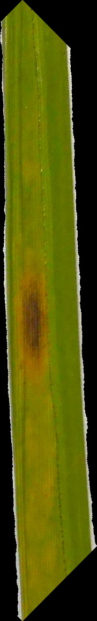
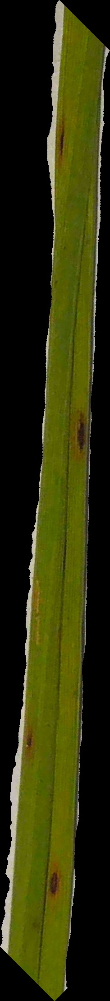
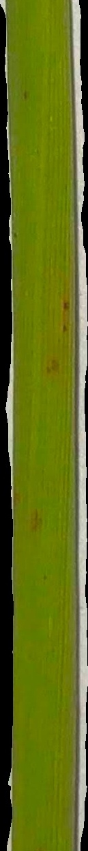
2.Maximize background cutting with opencv
result：

Slide 8
METHODS + RESULTS

Slide 9
Decision Tree & KNN
Name: Daijiao Liu

Slide 10
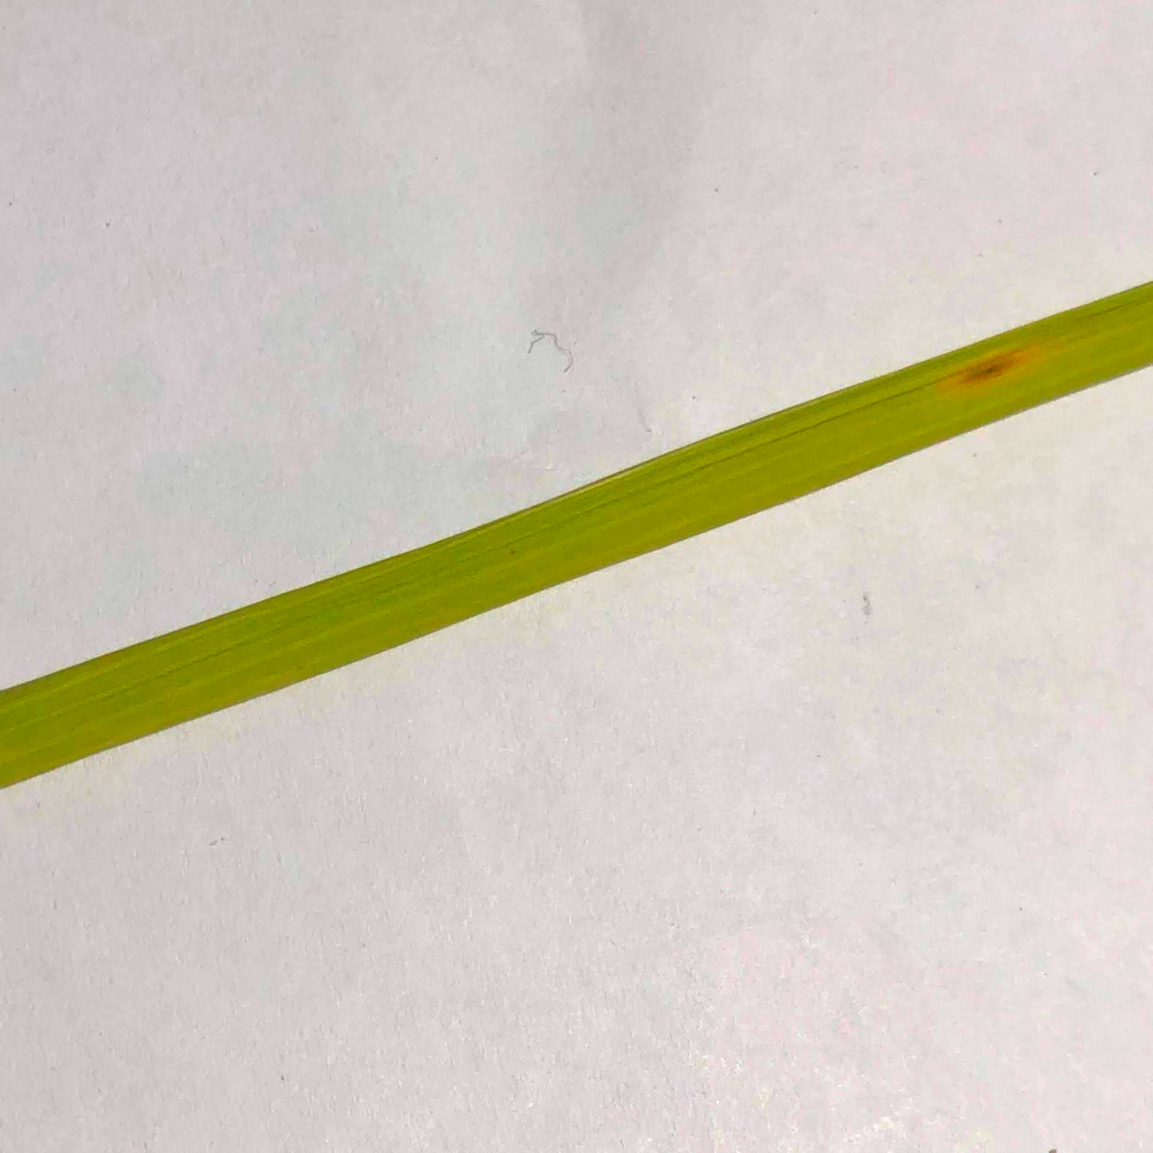
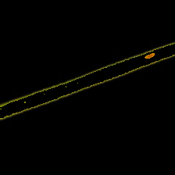
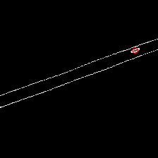
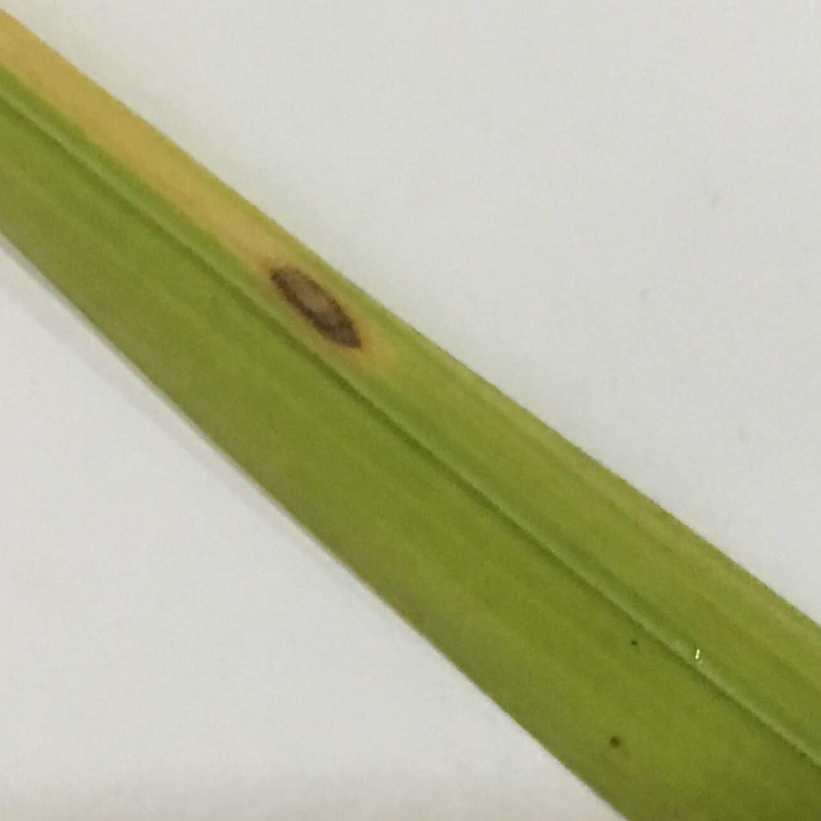
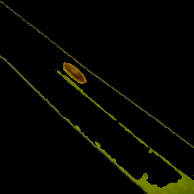
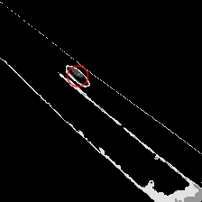
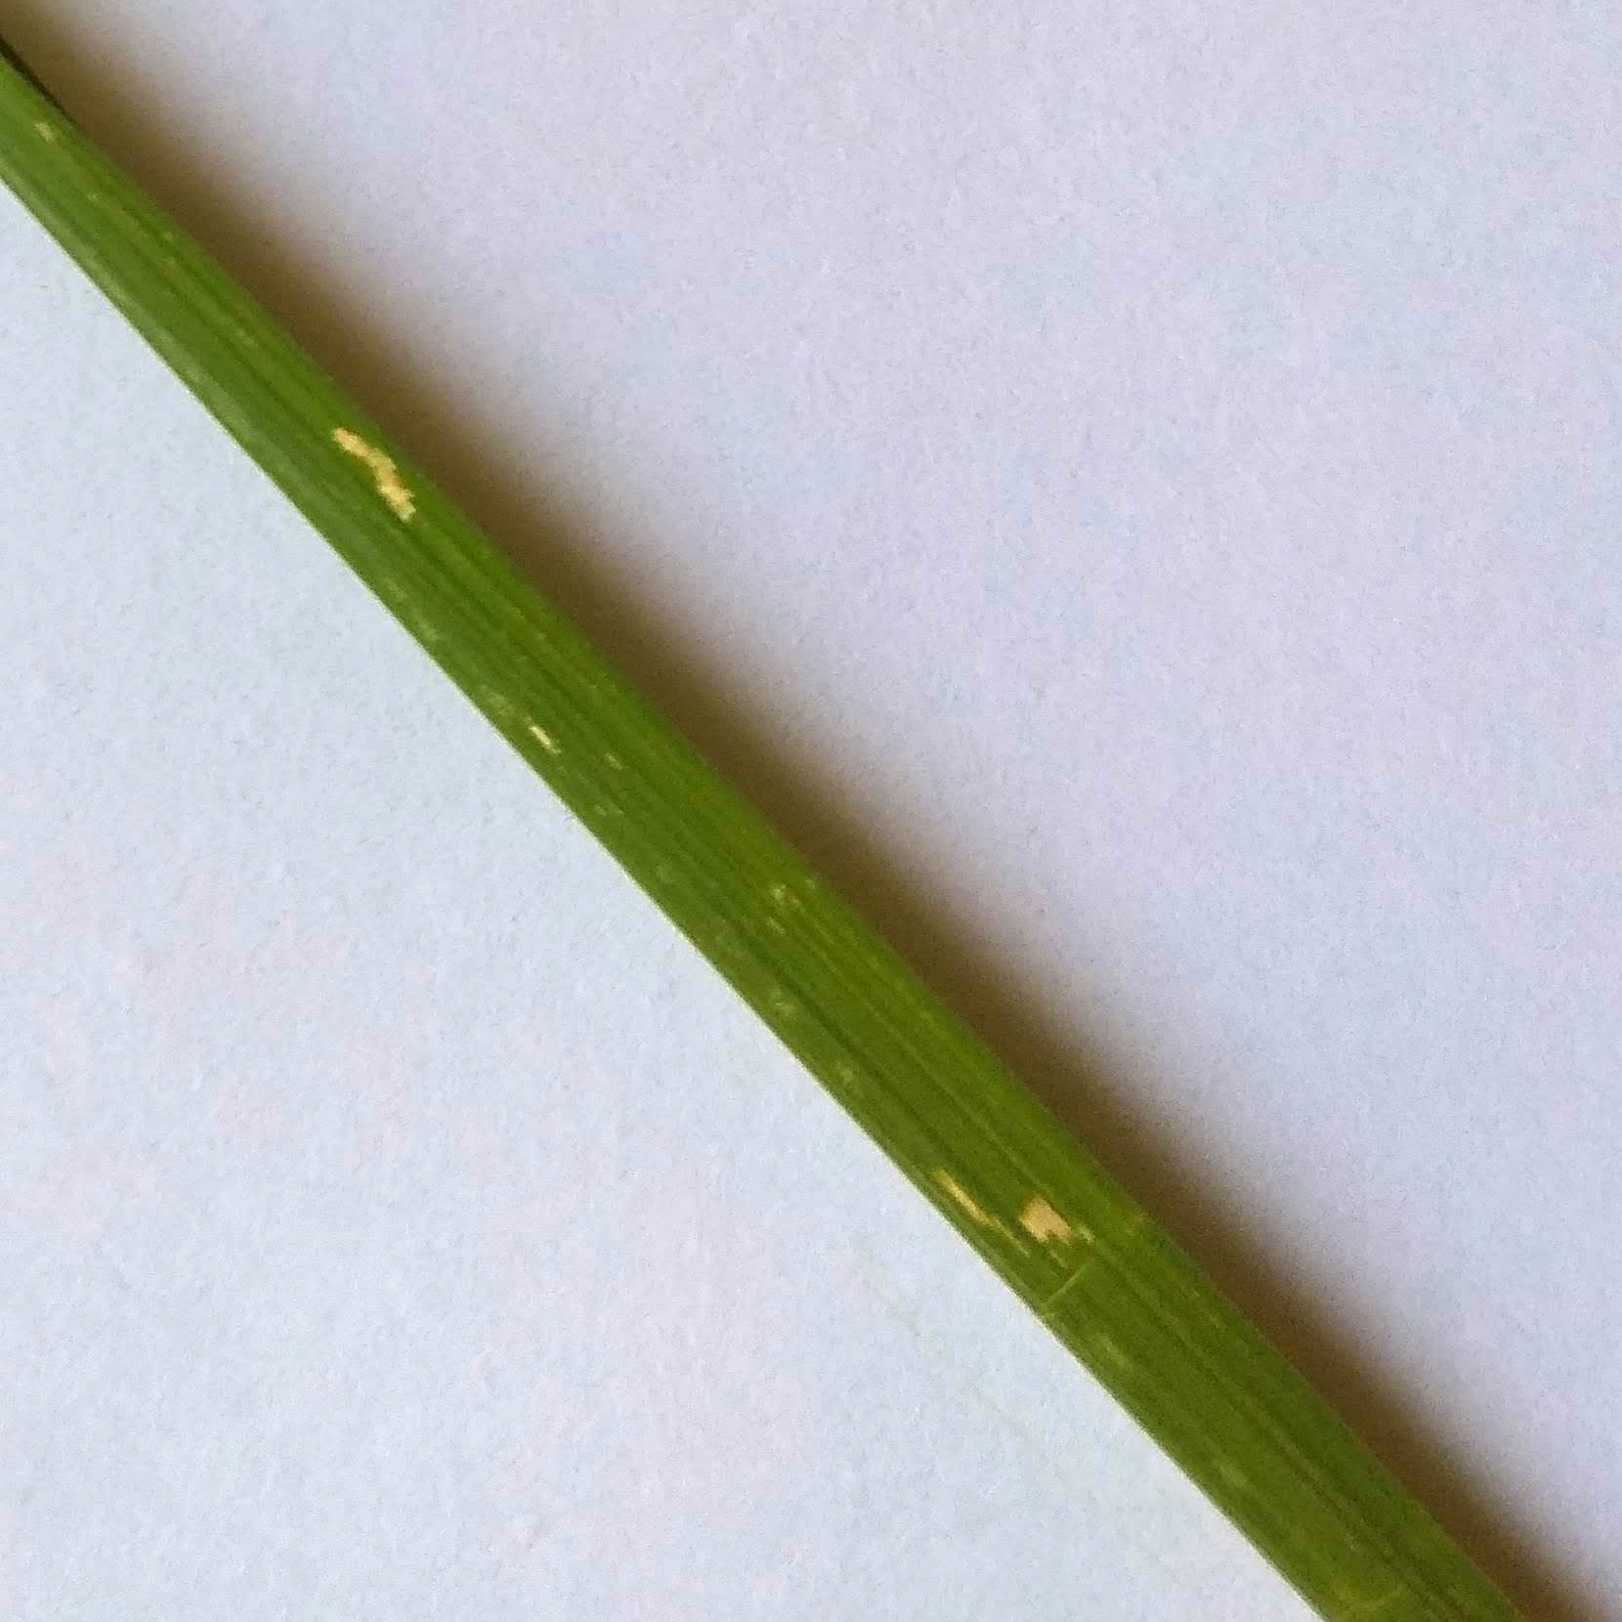
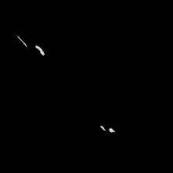
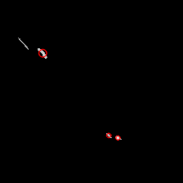
Methods Decision Tree (feature extraction)
Example (OpenCV):
Brown Blob
Dark Blob Color | Dark Blob Size | Light Blob Shape | Mean Leaf Color (rgb) | TARGET Classification
Brown | Numbers (numerical feature) | Long Strip | Numbers (numerical feature) | Healthy
Brown outside Light inside |  | Round |  | Leaf Blast
None |  | None |  | Brown Spot
 |  |  |  | Hispa
Brown Outside Light inside Blob
Long Strip Light Blob
Notes:
the object structure and shape can be extracted as a feature vector by the distribution of intensity gradients
HOG is adopted as the baseline method because a). HOG emphasizes the shape and structure of the object in the image and b). it requires less computation power.
You Only Look Once (YOLO) is an object detection (single neural network ) model proposed by Redmon et al. in 2015 to obtain specific location and category information for target detection by direct regression
Choose yolo, based on the previous research better than previous neural network e.g. R –CNN, F-CNN. YOLO also runs fast as it only look at each iamge onece.

Slide 11
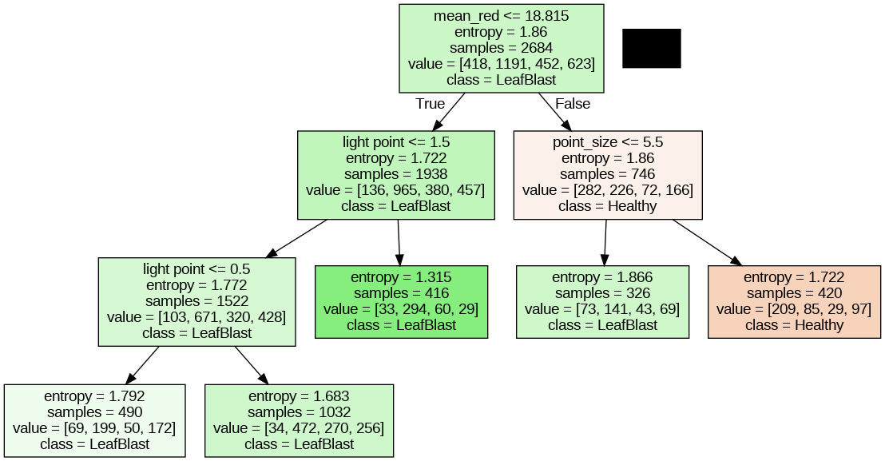
Methods Decision Tree
The quality of Decision Tree
is extremely depend on the features of artificial division.
C4.5 with post-pruning
CaRT
C4.5
 | Accuracy (train) | Accuracy (validation) | Pre-pruning | Post-pruning
CaRT | 0.557 | 0.450 | Max depth = 6 | None
C4.5 | 0.583 | 0.441 | Max depth = 7 | None
C4.5 | 0.490 | 0.455 | None | ccp_alpha=0.02
Notes:
the object structure and shape can be extracted as a feature vector by the distribution of intensity gradients
HOG is adopted as the baseline method because a). HOG emphasizes the shape and structure of the object in the image and b). it requires less computation power.
You Only Look Once (YOLO) is an object detection (single neural network ) model proposed by Redmon et al. in 2015 to obtain specific location and category information for target detection by direct regression
Choose yolo, based on the previous research better than previous neural network e.g. R –CNN, F-CNN. YOLO also runs fast as it only look at each iamge onece.

Slide 12
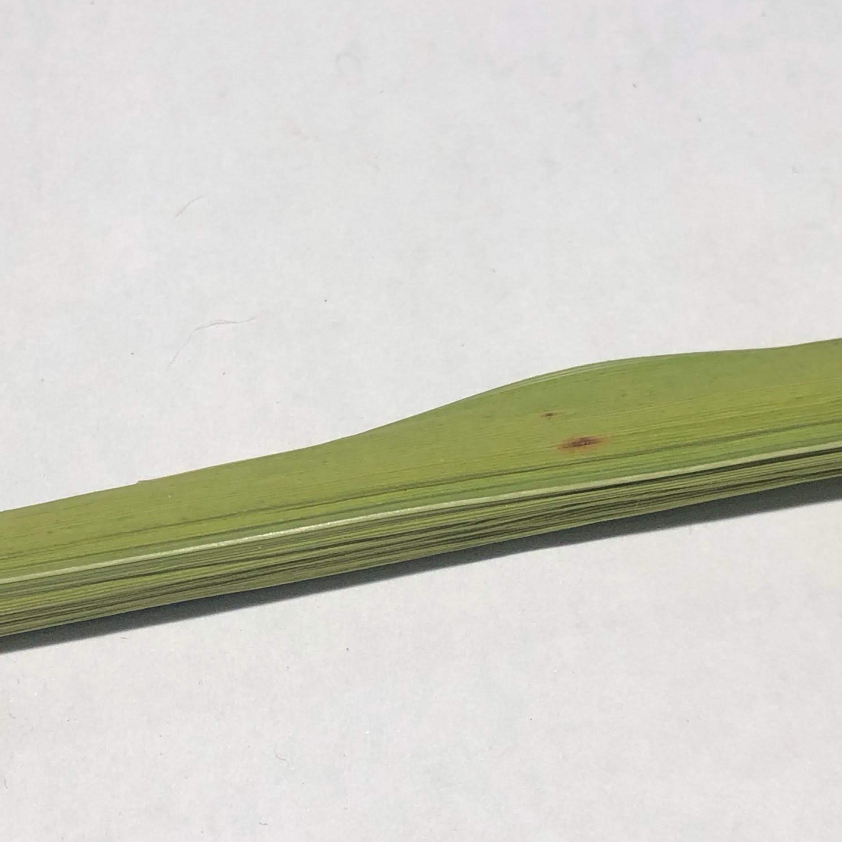
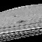
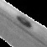
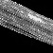
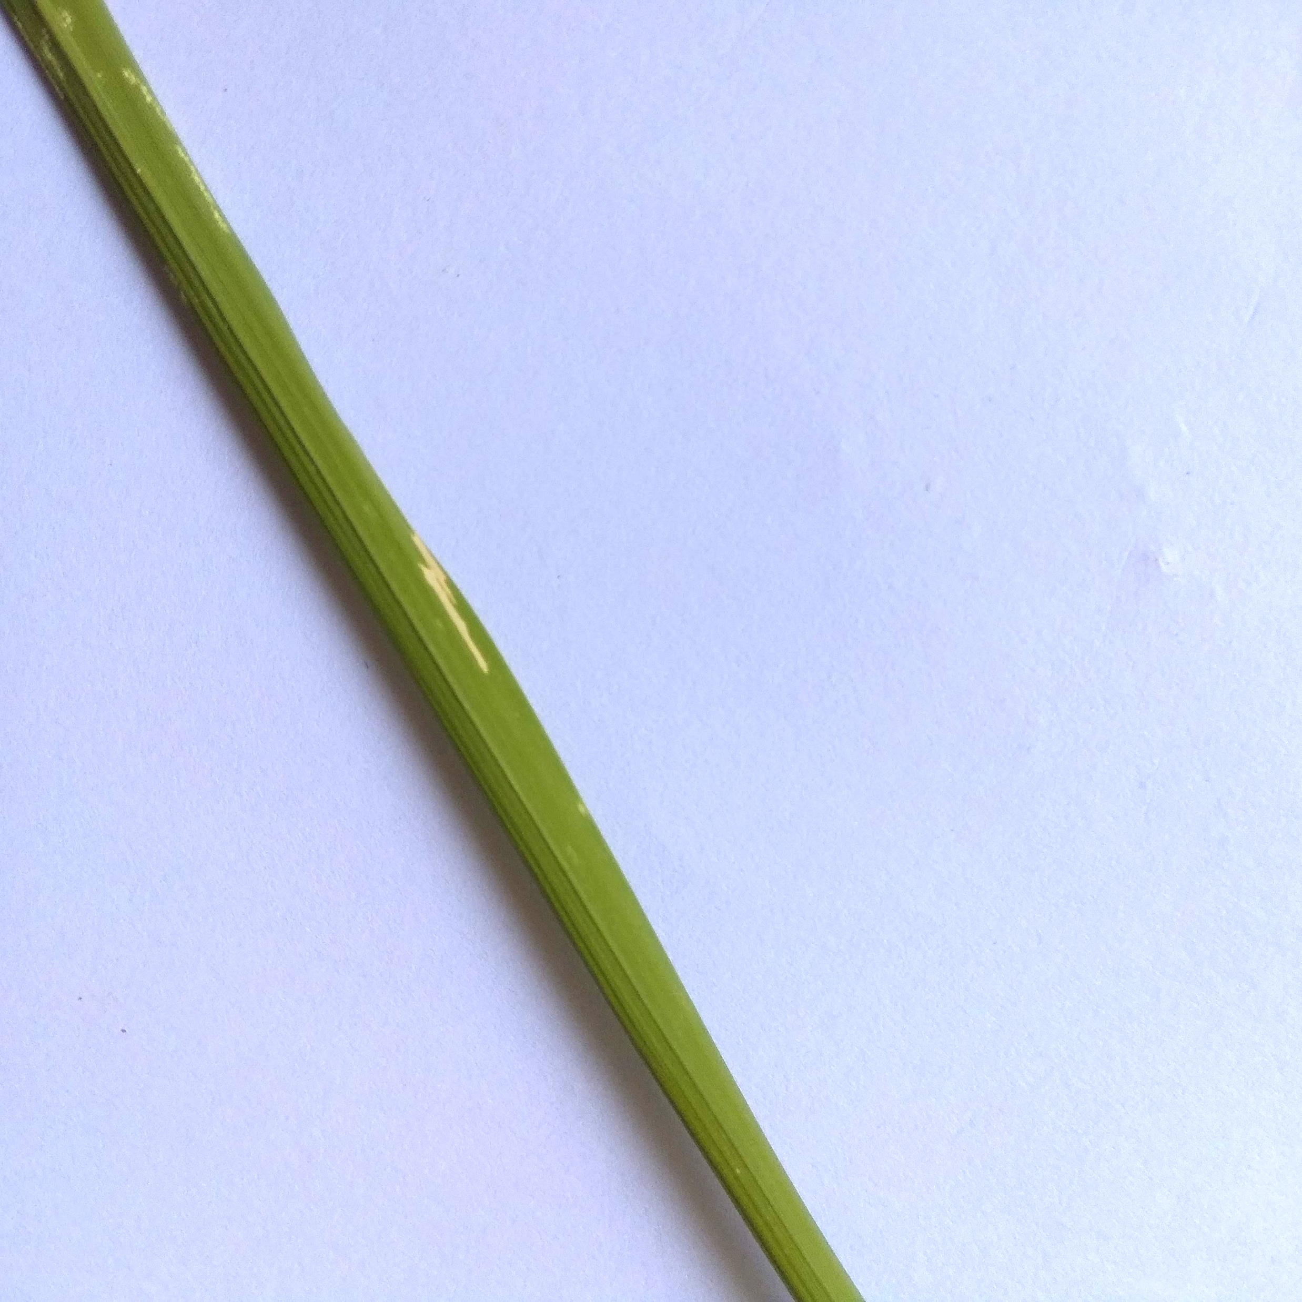
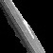
Methods KNN
Euclidean distance:
Manhattan distance:
…
 | K | Accuracy | Precision (mean) | Recall(mean) | F1 score
Euclidean | 25 | 0.483 | 0.419 | 0.421 | 0.420
Manhattan | 25 | 0.466 | 0.363 | 0.370 | 0.367
……
 | Healthy | Hispa | Brown Spot | Leaf Blast
Precision | 0.515 | 0.385 | 0.341 | 0.436
Recall | 0.828 | 0.047 | 0.349 | 0.151
…
56*56*1
Differences in precision and recall for different categories
Error of cutting image based on lesion location
All points in each neighbourhood are weighted equally
Without highlight the weight of lesion
224*224*3
Notes:
the object structure and shape can be extracted as a feature vector by the distribution of intensity gradients
HOG is adopted as the baseline method because a). HOG emphasizes the shape and structure of the object in the image and b). it requires less computation power.
You Only Look Once (YOLO) is an object detection (single neural network ) model proposed by Redmon et al. in 2015 to obtain specific location and category information for target detection by direct regression
Choose yolo, based on the previous research better than previous neural network e.g. R –CNN, F-CNN. YOLO also runs fast as it only look at each iamge onece.

Slide 13
CNN architecture & Performance
Name: ZHIYUE ZHENG

Slide 14
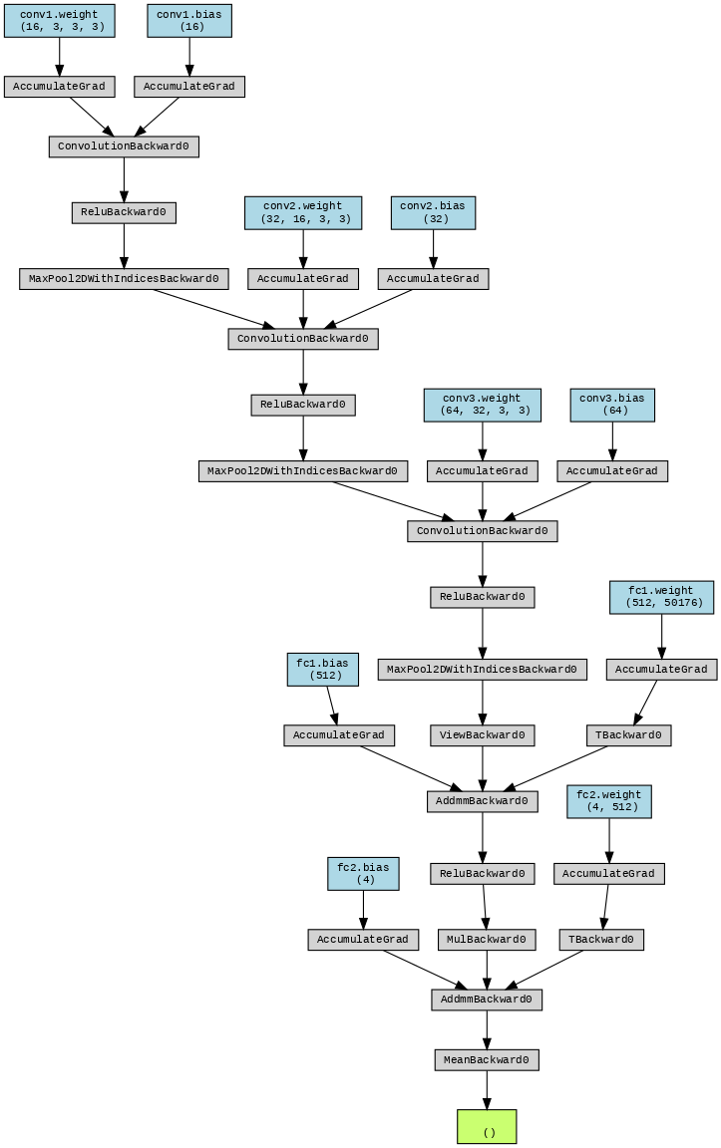
Non-pretrained simple CNN model
Architecture parameters:
Convolutional layer kernel size: 3 * 3
Convolutional layer 1 output channel: 16
Convolutional layer 2 output channel: 32
Convolutional layer 3 output channel: 64
Max-pooling layer kernel size: 2 * 2
Training parameters:
Optimizer: Adam optimizer
Learning rate: 0.001
Epochs: 60
Loss function: Cross entropy loss

Slide 15
Performance
 | Accuracy | Precision | Recall | F1 Score
Training set | 0.7966 | None | None | None
Validation set | 0.5970 | 0.5791 | 0.5970 | 0.5879
Testing set | 0.5625 | 0.5448 | 0.5625 | 0.5402
Table 1. Evaluation metrics after 60 epochs when trained on the original dataset.
 | Accuracy | Precision | Recall | F1 Score
Training set | 0.9742 | None | None | None
Validation set | 0.6893 | 0.6670 | 0.6893 | 0.6780
Testing set | 0.6399 | 0.6358 | 0.6399 | 0.6348
Table 2. Evaluation metrics after 60 epochs when trained on the preprocessed dataset.

Slide 16
Pretrained CNN Model
Name: Yanqi Zhu

Slide 17
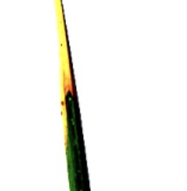
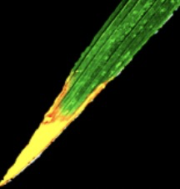
Methods
Pretrained CNN model
Hyper parameter
Model Selection
Model
Fine Tuning
Testing
Adjust structure
DenseNet
ResNet
Vgg
CNN+SVM ...
original
Optmizer
Learning Rate
Additioanl Layers
pre-processed
Evaluation metrics: Accuracy, Precision, F1 and Recall

Slide 18
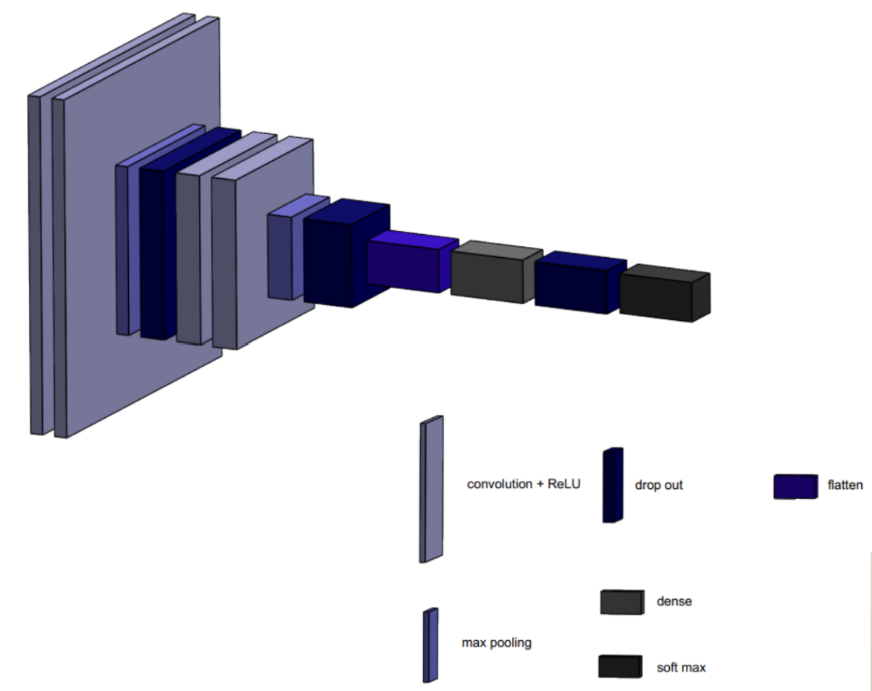
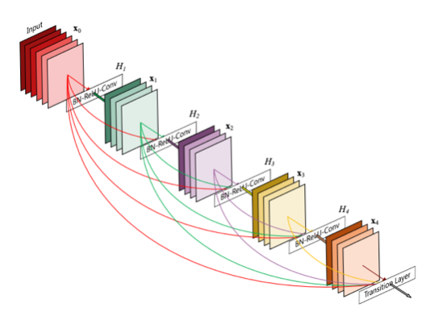
Methods
Pretrained CNN model
Traditional CNN
DenseNet-201
Notes:
the object structure and shape can be extracted as a feature vector by the distribution of intensity gradients
HOG is adopted as the baseline method because a). HOG emphasizes the shape and structure of the object in the image and b). it requires less computation power.
You Only Look Once (YOLO) is an object detection (single neural network ) model proposed by Redmon et al. in 2015 to obtain specific location and category information for target detection by direct regression
Choose yolo, based on the previous research better than previous neural network e.g. R –CNN, F-CNN. YOLO also runs fast as it only look at each iamge onece.

Slide 19
Results
 | Optimizer | Accuracy | Precision | F1 Score | Recall | Algorithm execution time/s
Original test dataset | Adam | 0.8036 | 0.8205 | 0.8072 | 0.8036 | 42.488
Pre-processed test dataset | Adam | 0.8601 | 0.8650 | 0.8564 | 0.8601 | 83.32
Original test dataset | SGD | 0.7054 | 0.6872 | 0.6856 | 0.7054 | 84.446
Pre-processed test dataset | SGD | 0.7976 | 0.7967 | 0.7962 | 0.7976 | 63.935
With original data 80%
DenseNet-201
Accuracy
With pre-processed data 86%

Slide 20
DISCUSSION + CONCLUSION
Result summary on preprocessed dataset
Model used | Accuracy (Testing set) | F1 Score
Decision Tree | 0.450 | Nil
KNN | 0.483 | 0.420
Pretrained CNN Model | 0.8601 | 0.8564
CNN | 0.6399 | 0.6348
Notes:
the object structure and shape can be extracted as a feature vector by the distribution of intensity gradients
HOG is adopted as the baseline method because a). HOG emphasizes the shape and structure of the object in the image and b). it requires less computation power.
You Only Look Once (YOLO) is an object detection (single neural network ) model proposed by Redmon et al. in 2015 to obtain specific location and category information for target detection by direct regression
Choose yolo, based on the previous research better than previous neural network e.g. R –CNN, F-CNN. YOLO also runs fast as it only look at each iamge onece.

